Slide 1
Affecting the shared journey of two players by affecting the relationship between their in-game characters.
By Heather Bishop

Slide 2
What Does That Even Mean?
Originally was going to be about taking a player through various emotional twists and turns by creating this deep meaningful bond between player and character. Specific emotions TBC.
To do that I needed Players to care about their in game characters, and empathise with them so that there was a maximum emotional impact to events of the story.
The multiplayer was intended to be a tool I used to get players to care about their avatar/character and shouldn’t have been in the title or proposal.

Slide 3
On The Subject Of Empathy
Everything I read about getting individuals to care about characters keeps mentioning empathy, so what is it?
Empathy consists of three separate components.
The first is “cognitive empathy,” simply knowing how the other person feels and what they might be thinking. Sometimes called perspective-taking, this kind of empathy can help in, say, a negotiation or in motivating people.
Then there’s “emotional empathy,” – when you feel physically along with the other person, as though their emotions were contagious. This emotional contagion, social neuroscience tells us, depends in large part on the mirror neuron. Emotional empathy makes someone well-attuned to another person’s inner emotional world.
Finally, there’s “compassionate empathy,”. With this kind of empathy we not only understand a person’s predicament and feel with them, but are spontaneously moved to help, if needed.
Goleman, D (2007) Three Kinds OF Empathy Cognitive Emotional Compassionate [Online] Viewed On: 26/09/17. Available At: http://www.danielgoleman.info/three-kinds-of-empathy-cognitive-emotional-compassionate/

Slide 4
Cooperation Encourages Empathy
An vital point for consideration with cooperative games is that: “Players often construct a unique narrative to flesh out the actual in-game events”(Maynard, D. Herron, J : 2016). By allowing players to collaborate strategically (to win the game), they also engage in a second collaborative process: interactive storytelling.
Another important consideration when crafting a cooperative game is the importance of failure in the game. Jesper Jul argues that failure in games is vital to produce a fulfilling experience, however it is always painful or at least unpleasant. (Maynard, D : 2016).
Timing matters, the cooperative effects are short lived. If the desired experience is for players to act with cohesion, trust and cooperation do it immediately after they’ve collaborated or acted cooperatively. (Madigan, J : 2012).
Madigan, J (2012) Competition vs. Cooperation in Video Games [Online] Viewed On 19/09/17. Available At: https://www.psychologytoday.com/blog/mind-games/201208/competition-vs-cooperation-in-video-games
Maynard, D. Herron, J (2016) The Allure OfStruggle And Failure In Cooperative Board Games [Online] Viewed On 19/09/17. Available At: http://analoggamestudies.org/2016/05/the-allure-of-struggle-and-failure-in-cooperative-board-games/#note-11

Slide 5
Role Playing or Observing
Whilst player created avatars will create a more immediate sense of empathy and connection, due to players imprinting their most desired self on the avatar and that avatars expected behaviour then affecting the players actual behaviour – this must be balanced carefully. (Madigan, J : 2013).
Alternatively if players use characters created for them it takes time to build empathy, and requires depth and finesse that I (personally) am finding hard to achieve with cards. However I will have more control over the character arc, and the ultimate experience the player has with their avatar. (Fuchs, M. S. : 2017).
Madigan, J. (2013). The Psychology of Video Game Avatars. [online] The Psychology of Video Games. Available at: http://www.psychologyofgames.com/2013/11/the-psychology-of-video-game-avatars/ [Accessed 11 Nov. 2017].
Fuchs, M. S. (2017). STORY. [online] Dispatch from the Razors' Edge. Available at: http://www.michaelfuchs.org/razorsedge/?story=2014-05-27 [Accessed 11 Nov. 2017].

Slide 6
Narrative
Failures of character emotional impact could be due to a weak narrative that doesn’t really contain any meaningful conflict.
And then this happened:
Olive, J (2015) Procedural Narrative In Card Games [Online] Viewed On: 20/10/17. Available At: http://sites.gsu.edu/jolive1/2015/02/18/procedural-narrative-in-card-games/

Slide 7
Down The Rabbit Hole I Go…
Ingold, J (2015) Adventures In Text: Innovating in Interactive Fiction. [Online] Viewed On: 20/10/17. Available At: http://www.gdcvault.com/play/1021774/Adventures-in-Text-Innovating-in
Ashwell, S (2015) Standard Patterns In Choice Based Games. [Online] Viewed On: 20/10/17. Available At: https://heterogenoustasks.wordpress.com/2015/01/26/standard-patterns-in-choice-based-games/
Famularo, J (2016) 5 Fantastic Story Driven Board Game. [Online] Viewed On: 20/10/17. Available At: http://geekandsundry.com/5-fantastic-story-driven-board-games/
Olive, J (2015) Procedural Narrative In Card Games [Online] Viewed On: 20/10/17. Available At: http://sites.gsu.edu/jolive1/2015/02/18/procedural-narrative-in-card-games/
Brown, D (2015) Can You Tell Your Story Without Words? [Online] Viewed On: 20/10/17. Available At: https://dannybrown.me/2015/04/13/can-you-tell-your-story-without-using-words/
O. Riedl, Mark & Bulitko, Vadim. (2013). Interactive Narrative: An Intelligent Systems Approach. AI Magazine. 34. 67-77.
Louchart, Sandy. (2017) The Emergent Narrative Theoretical Investigation. [Online] Viewed On: 11/10/17 Available At: http://www.macs.hw.ac.uk/~ruth/Papers/ narrative/LouchartAylettNile04.pdf
Louchart, Sandy & Aylett, Ruth. (2017). Emergent narrative, requirements and high-level architecture. [Online] Viewed On: 11/10/18. Available At: http://www.academia.edu/544501/The_emergent_narrative_theoretical_investigation
Ellison, C (2016) Four Games That Tell Great Stories And How They Do It [Online] Viewed On: 17/05/17. Available At: https://www.theguardian.com/technology/2016/apr/11/four-games-that-tell-great-stories-and-how-they-do-it
Campbell, O (2015) Are Video Games The New Great Medium For Telling Stories? [Online] Viewed On: 17/05/17. Available At: http://www.escapistmagazine.com/articles/view/video-games/14625-Video-Games-Tell-Stories-In-a-Way-No-Previous-Medium-Could
Galarneau, L (2014) How Stories Are Told In Games [Online] Viewed On: 17/05/17. Available At: http://www.bigfishgames.com/blog/how-stories-are-told-in-games/
Walker, J (2013) Games Are The Ideal Place For Telling Great Stories [Online] Viewed On: 17/05/17. Available At: https://www.rockpapershotgun.com/2013/06/12/games-are-the-ideal-place-for-telling-great-stories/
Lawrence, S (N.D) The Power Of Visual Storytelling [Online] Viewed On: 17/05/17. Available At: http://curve.gettyimages.com/article/the-power-of-visual-storytelling
Shlomi, R (2016) What Is Visual Storytelling? [Online] Viewed On: 17/05/17. Available At: http://www.visualstorytell.com/blog/what-is-visual-storytelling
Crockett, L (2001) 10 Powerful Visual Storytelling Techniques. [Online] Viewed On: 17/05/17. Available At: https://globaldigitalcitizen.org/10-visual-storytelling-techniques
Chibana, N (2015) 7 Storytelling Techniques Used By The Most Inspiring TED Presenters. [Online] Viewed On: 17/05/17. Available At: http://blog.visme.co/7-storytelling-techniques-used-by-the-most-inspiring-ted-presenters/
Smith H, Worch, M (2010) What Happened Here? Environmental Storytelling. [Online] Viewed On: 17/05/17. Available At: http://www.gdcvault.com/play/1012647/What-Happened-Here-Environmental
Pitzer, A (2011) Harvey Smith On Environmental Storytelling Embedding Narrative. [Online] Viewed On: 17/05/17. Available At: http://niemanstoryboard.org/stories/harvey-smith-on-environmental-storytelling-and-embedding-narrative/
Carson, D (2000) Environmental Storytelling: Creating Immersive 3D Worlds Using Lessons Learned From The Theme Park Industry. [Online] Viewed On: 17/05/17. Available At: http://www.gamasutra.com/view/feature/131594/environmental_storytelling_.php
Bureman, L (2013) The 7 Types Of Plots. . [Online] Viewed On: 17/05/17. Available At: http://thewritepractice.com/7-plots/
Nichol, M (2013) 7 Types Of Narrative Conflict. [Online] Viewed On: 17/05/17. Available At: http://www.dailywritingtips.com/7-types-of-narrative-conflict/

Slide 8
It Happened Again
BoardGameGeek. (2018). Dungeons & Dragons: The Fantasy Adventure Board Game. [online] Available at: https://boardgamegeek.com/boardgame/6366/dungeons-dragons-fantasy-adventure-board-game [Accessed 30 Oct. 2017].
And I became obsessed with the idea of creating a tabletop RPG, and giving control to the player and giving them the tools to tell their own story, with their own characters.
*SPOILERS* It doesn’t go well.

Slide 9
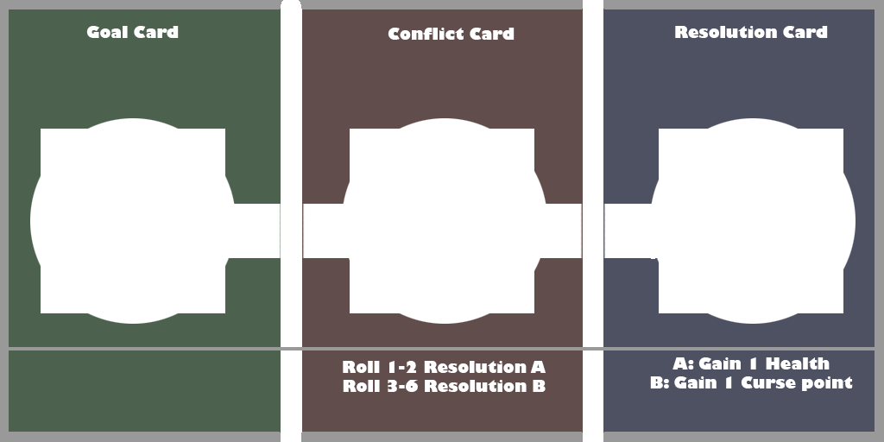
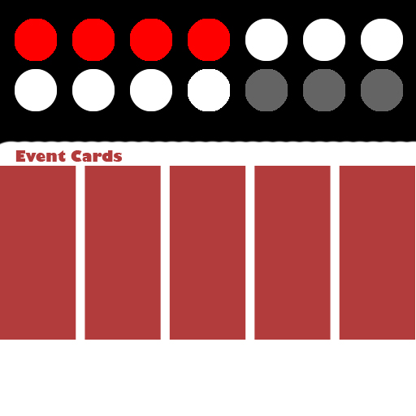
Burn It All, Try Again.
This game will be a storytelling card game with mild RPG elements. A group of 2-6 players will slowly make their way through a shared deck of cards in order to tell the story of how their character will cure a family curse by using cards to construct scenes.

Slide 10
Players Almost Care About Their Characters
But they cared more about telling their story, than they did about the characters themselves.

Slide 11
What Next?
The problem is I am struggling to use any of the research I have conducted in a meaningful way.
Partially due to the fact that empathy is a frustratingly inconsistent area of research, meaning that at times the research is not consistent in terms of terminology and definition.
Struggling to achieve emotional responses beyond “fun” non-digitally.
Playtesting challenges with non-digital because it takes a long time to playtest very few people.

Slide 12
Back To Sanity
Focus on creating character-player bonds in one person.
By simply talking about cognitive (“I understand/am that person”) and emotional (“I feel with/because of that person”) types of empathy only.
Empathy is directly related to an individuals perception. Both Dr. Singer and Heider/Simmel experiments revealed that individuals empathised with those similar to them, and even more with people/characters that they perceived to be experiencing unjust conflict.
Movement provides perception of life and personality.
Psychology. (2015). Fritz Heider & Marianne Simmel: An Experimental Study of Apparent Behavior. [online] Available at: https://www.all-about-psychology.com/fritz-heider.html [Accessed 24 Jan. 2018].
Bergland, C. (2016). The Neuroscience of Empathizing With Another Person's Pain. [online] Available at: https://www.psychologytoday.com/blog/the-athletes-way/201606/the-neuroscience-empathizing-another-persons-pain [Accessed 24 Jan. 2018].
GraphicMama Blog. (2016). How to Convey Character's Personality Through Shape, Variance and Size. [online] Available at: https://graphicmama.com/blog/conveying-characters-personality/ [Accessed 22 Feb. 2018].

Slide 13
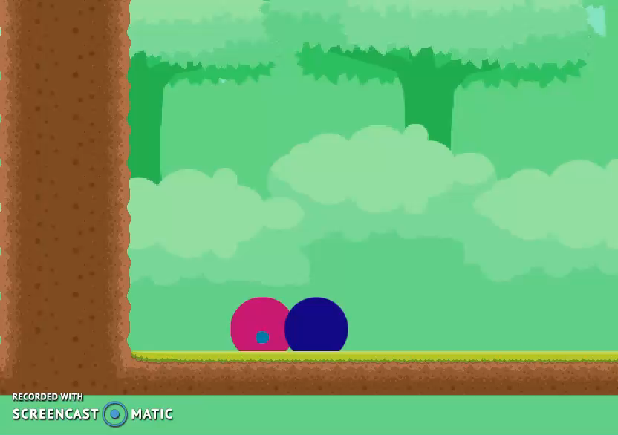
Digital Dabbling
Time to go Digital. Its more familiar, and I understand it a lot better than non-digital. It will also resolve playtesting difficulties.
-Circles for ambiguity of character, so players can have whatever perception of the character that comes naturally to them.
-Circles for shape of characters so they are perceived as friendly, harmless and safe.

Slide 14
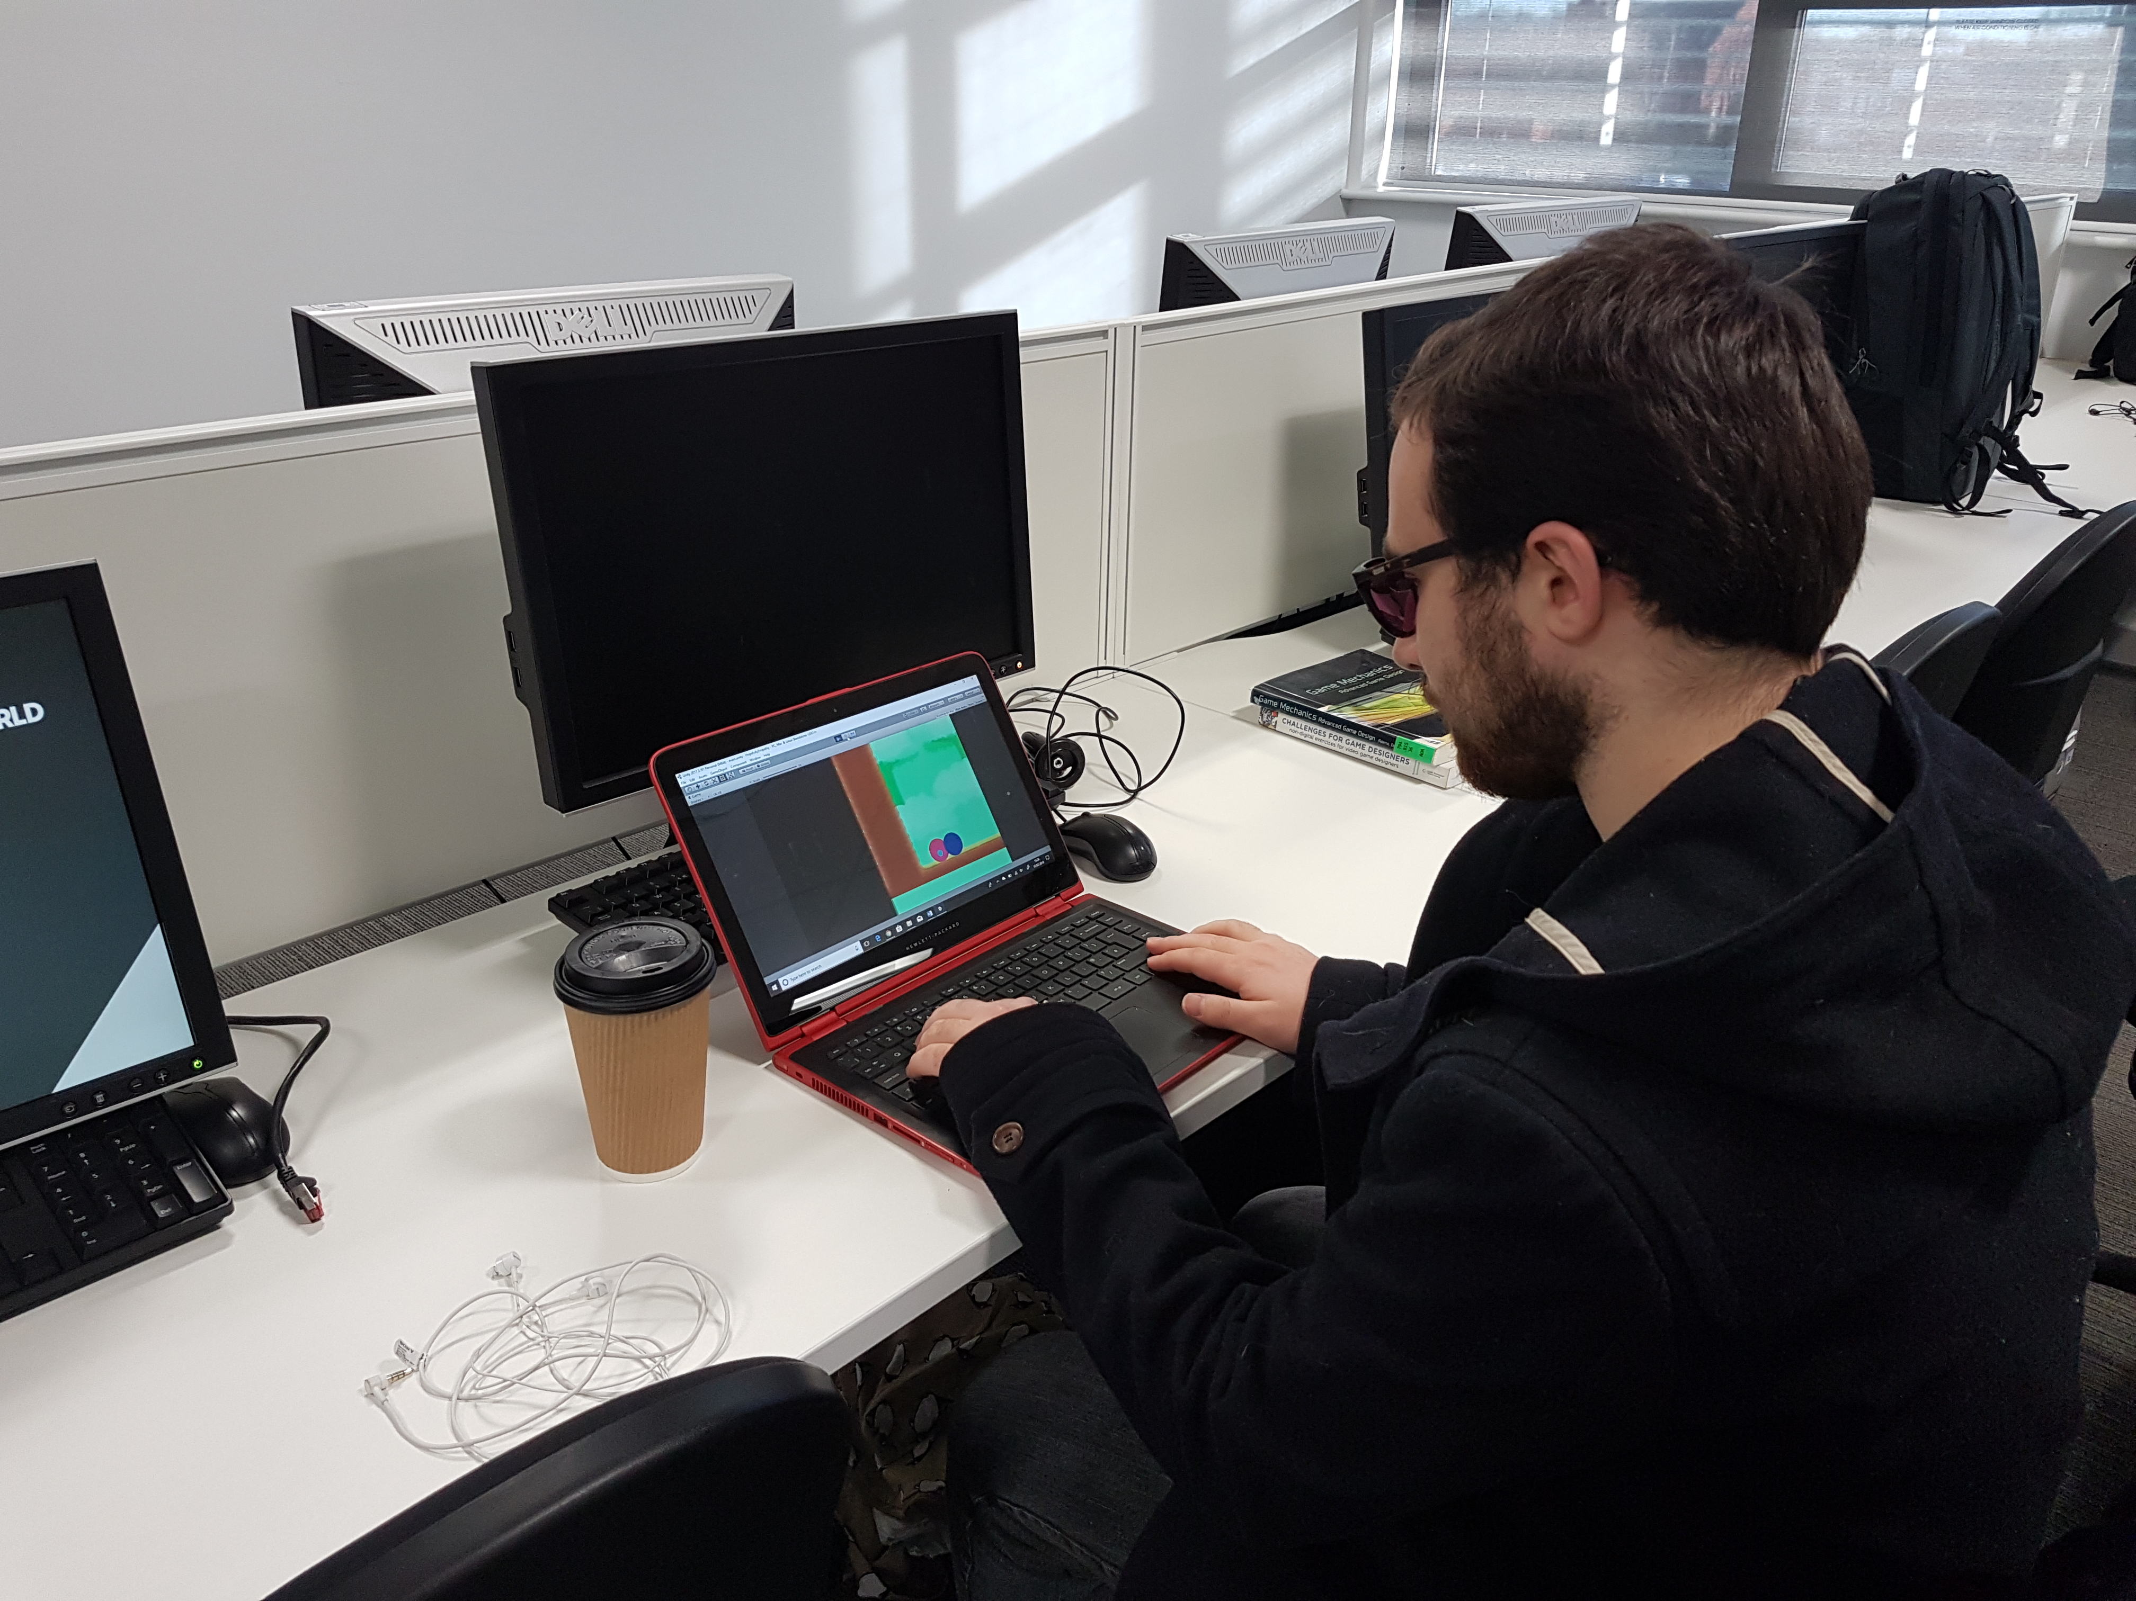
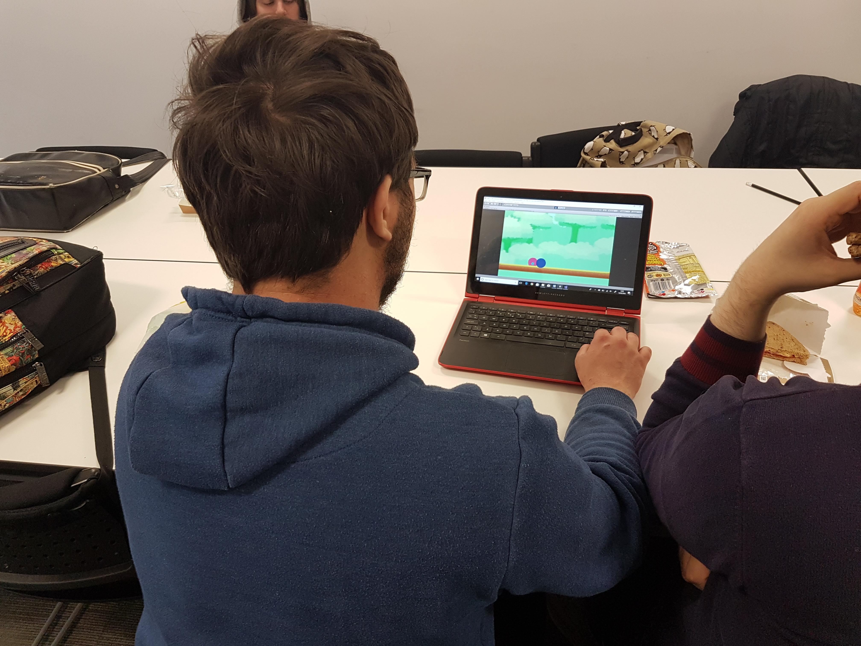
Results Of Playtesting - Empathy Adjacent
Still not quite empathy from players, but players did express concern about the characters on screen.
Half and half split, half cared and half didn’t.
“What’s With The Balls?” [Jamieson, D : 2018].
“Yeah, I can see what you’re going for there.” [Terry, W : 2018].
“We cant leave pink behind!” [Kingstone, T : 2018].

Slide 15
Refining Responses
Using a simpler version of the narrative from Group Project.
Having at least two heroes in the story, thus making it clear that it is not about a single protagonist the player might want to immediately identify with.
Using a caretaker theme.
Offering non-3D second person perspective;
Minimizing the cognitive load through simple mechanics and UI, and thus freeing up the mental space required for empathy to exist. [Chmielarz: 2013].
Chmielarz, A. (2013). Empathy in Game Design, or Why Some People Like Beyond: Two Souls. [online] The Astronauts. Available at: http://www.theastronauts.com/2013/11/empathy-game-design-people-like-beyond-two-souls/ [Accessed 12 Mar. 2018].
Maryflanagan.com. (2018). [online] Available at: http://www.maryflanagan.com/wp-content/uploads/cog-tech-si-g4g-article-1-belman-and-flanagan-designing-games-to-foster-empathy.pdf [Accessed 12 Mar. 2018].
Co.Design. (2015). How To Design A Game For Maximum Empathy. [online] Available at: https://www.fastcodesign.com/3046466/how-to-design-a-game-for-maximum-empathy [Accessed 12 Mar. 2018].
Jesperjuul.net. (2018). [online] Available at: http://www.jesperjuul.net/thesis/5-theplayerandthegame.html [Accessed 12 Mar. 2018].

Slide 16
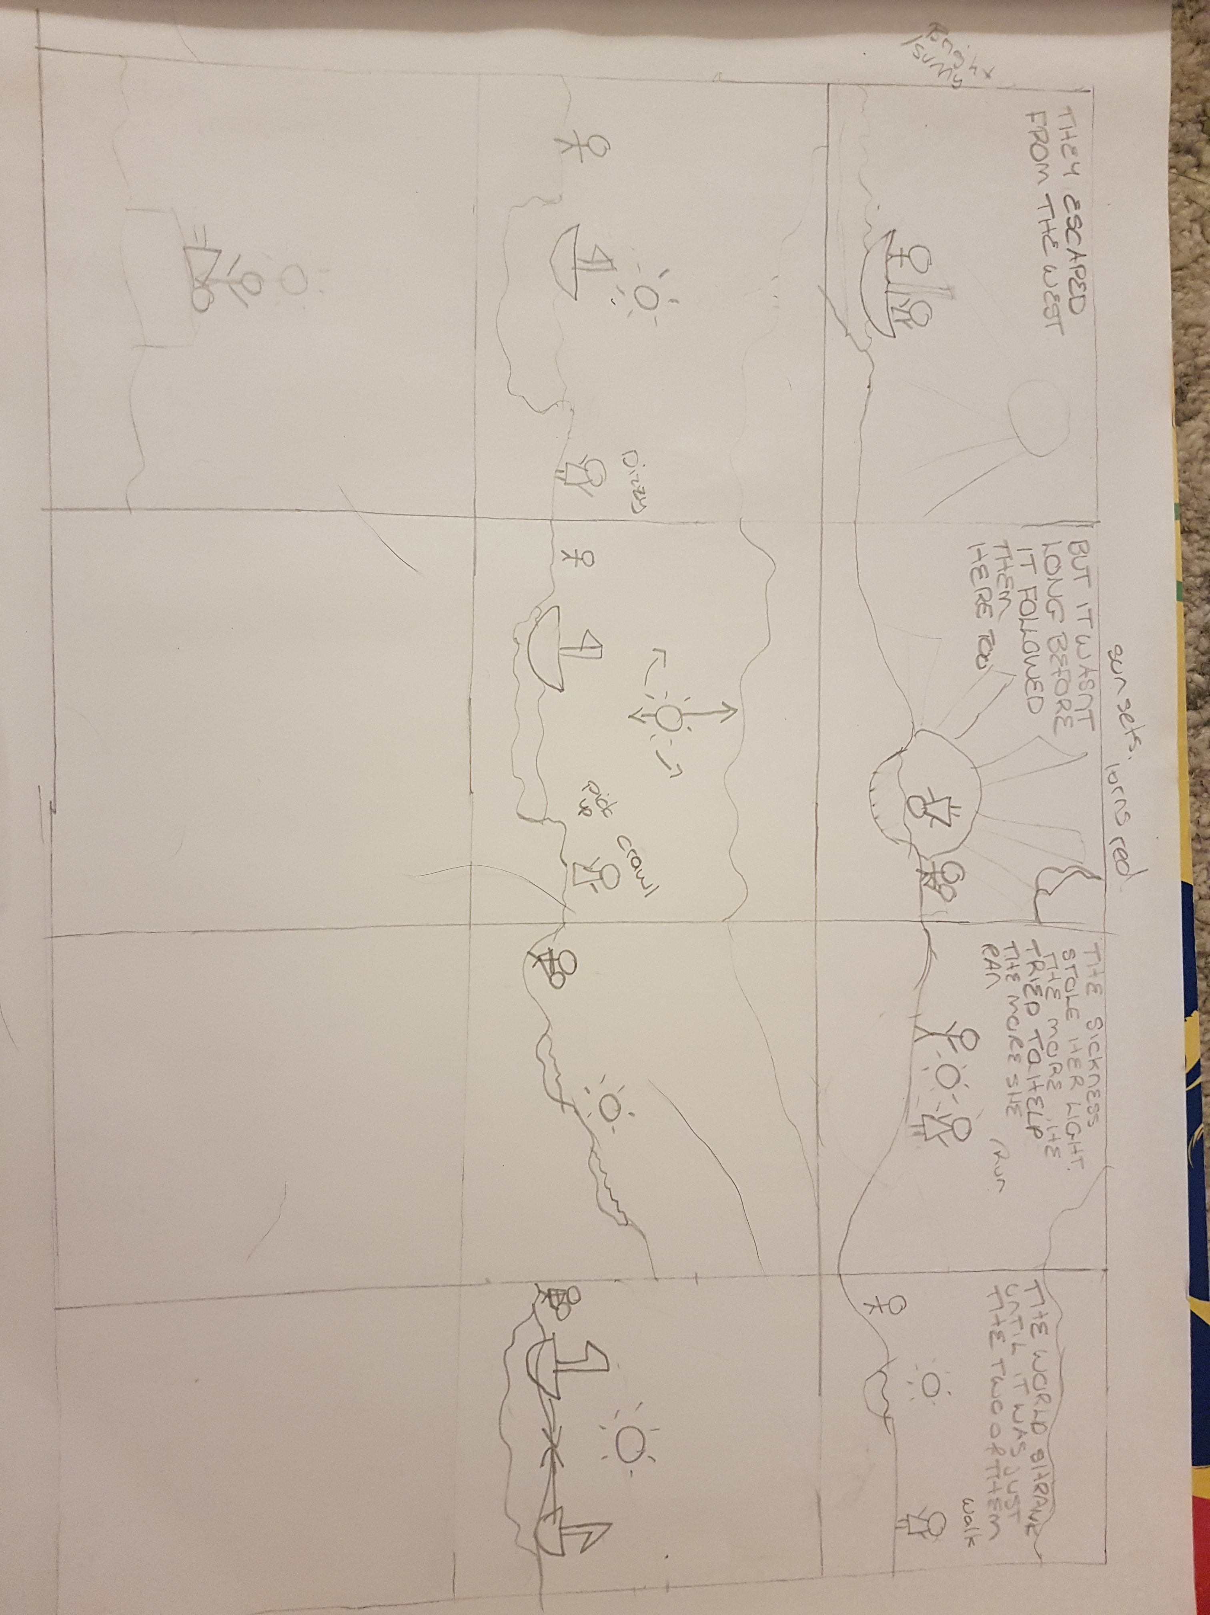
Storyboard
I hope to make players feel: sadness and joy.

Slide 17
Game Video

Slide 18
What Do I Hope To Hand In?
A linear 2D platformer single player game with a meaningful and emotionally impactful story and characters.
The measure of success will be through players self reporting (Questionnaires), and through video/picture logs of play throughs.

Slide 19
Questions?

